Slide 1

Project Name : Olist Store Analysis

Slide 2


Team Members
Vaishnavi Manusmare
Shruti Mishra
Sakshi More
Pranjal Yadav
Jeevana Bulla

Slide 3

Index
Introduction
KPI -1 : Weekday Vs Weekend payment Statistics.
KPI -2 : No. of Orders by review score 5 and payment type credit card.
KPI -3 : Avg no .of days taken for order delivery for pet shop.
KPI -4 : Avg Price and Avg Payments for Sao Paulo city.
KPI -5 : Average Shipping days Vs Review score.
Implementation of KPI’s using Ms excel.
Implementation of KPI’s using MYSQL.
Implementation of KPI’s using Power Bi.
Implementation of KPI’s using Tableau.
Conclusion.

Slide 4

Introduction
In the rapidly evolving world of e-commerce, businesses need to leverage data analytics to remain competitive.
Olist, a Brazilian-based company, provides a platform for small and medium-sized retailers to sell their products on major e-commerce marketplaces.
This allows sellers to expand their reach without having to manage individual marketplace accounts.
Analyzing the data generated from these transactions can provide critical insights into various aspects of the business, from sales performance to customer behavior and operational efficiency.

Slide 5
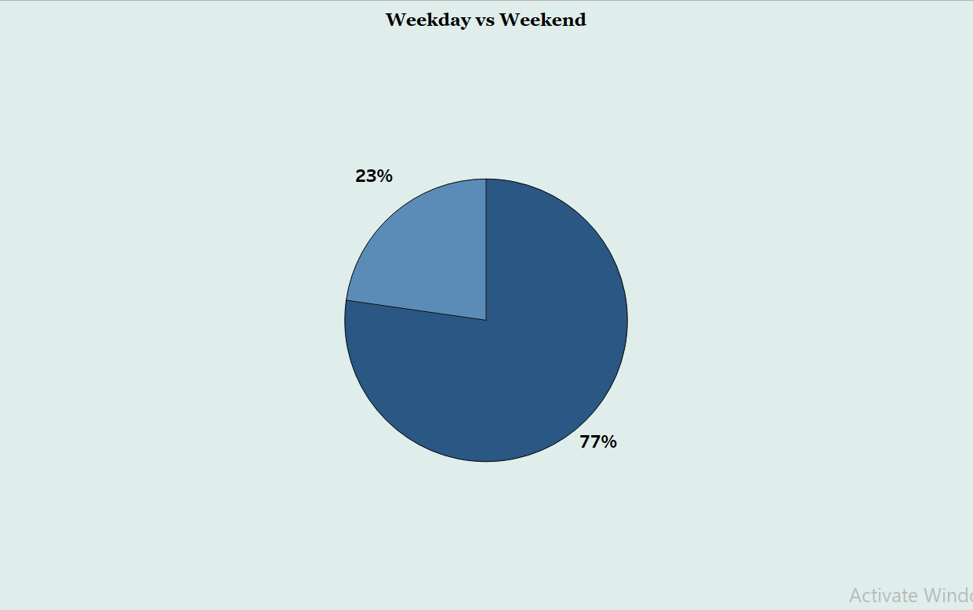
KPI – 1 Weekday Vs Weekend payment Statistics.
Insights :
Total Payments : $16.456 Million
Weekday Payments : $12.686 Million (77%)
Weekend Payments : $3.77 Million (23%)
Recommendations :
Weekends : Plan Promotional activities ( like Social media advertising , Paid advertising , Rewards and Loyalty Programs , etc. ) to boost revenue.
Weekdays : ensure you’re never out of stock. With these tactics, you can be sure your store’s product assortment will help you win more sales.

Slide 6
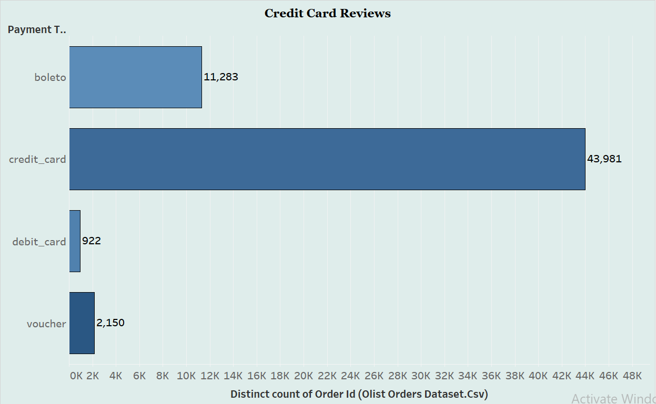
KPI – 2 No. of Orders by review score 5 and payment type credit card.
Insights :
Number of credit card orders with review score 5 : 44 K (57.83%)
For review score 5, credit cards are the most preferred payment method.
Recommendations :
Analyse the feedback and identify the root causes of the customer's dissatisfaction. Was it a product defect, shipping issue, customer service problem, or something else?
Implement corrective actions internally to prevent similar issues from recurring in the future.
Use negative feedback as an opportunity for learning and improvement. Analyze trends in negative reviews to identify common issues and implement systematic changes.

Slide 7
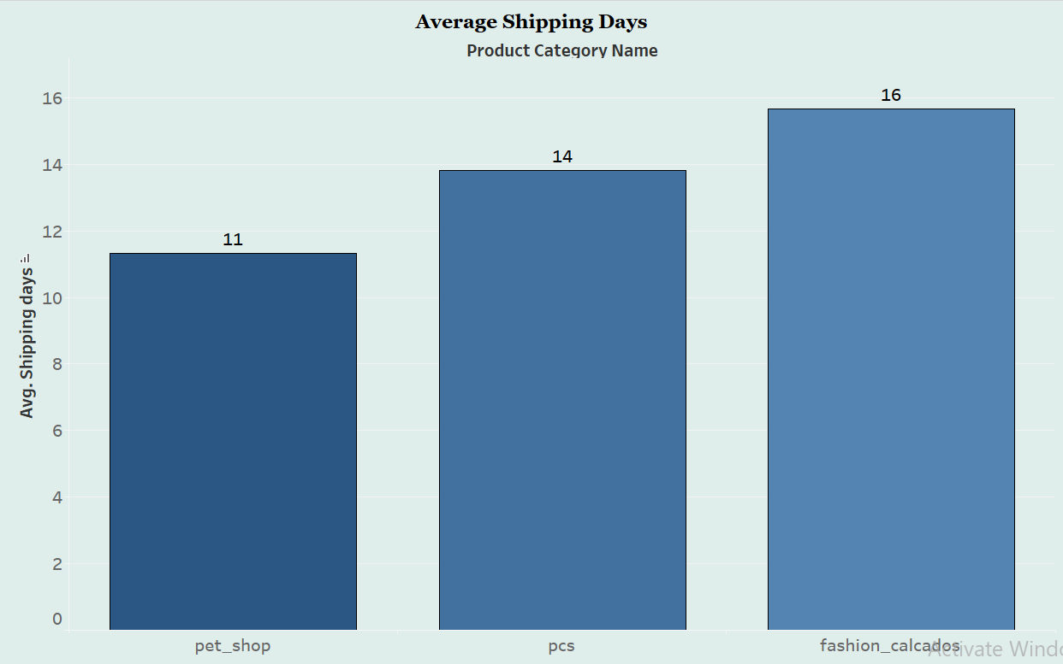
KPI – 3 Avg no .of days taken for order delivery for pet shop.
Insights : • Pet shop had 11.31 Average of Shipping Days.
Recommendations :
Ensure adequate stock levels for popular items to minimize delays caused by backorders or stockouts.
Evaluate shipping carriers based on their reliability, delivery times, and customer service reputation.
Standardize packaging processes to minimize time spent on packing orders.
Consider local distribution centers or fulfillment partners to expedite delivery for regional orders.

Slide 8
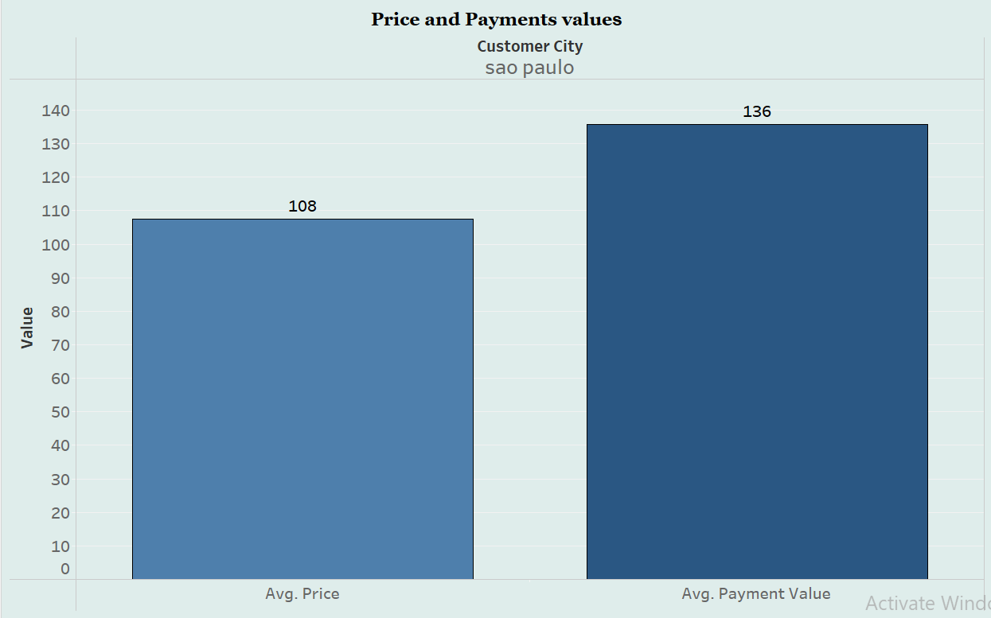
KPI – 4 Avg Price and Avg Payments for Sao Paulo city.
Insights :
﻿﻿﻿Sao Paulo had 107.53 Average of price and 135.83 Average of Payment value.﻿﻿
Average of payment value were 28.30 higher than Average of price.
Recommendations :
Conduct a thorough analysis of competitors' pricing strategies and customer preferences to ensure your prices are competitive yet profitable.
Ensure your products offer a clear value proposition that justifies the average price customers are paying.
Offer diverse payment methods to accommodate customer preferences and potentially increase average payment values.
Bundle complementary products or services to encourage customers to spend more per transaction.

Slide 9
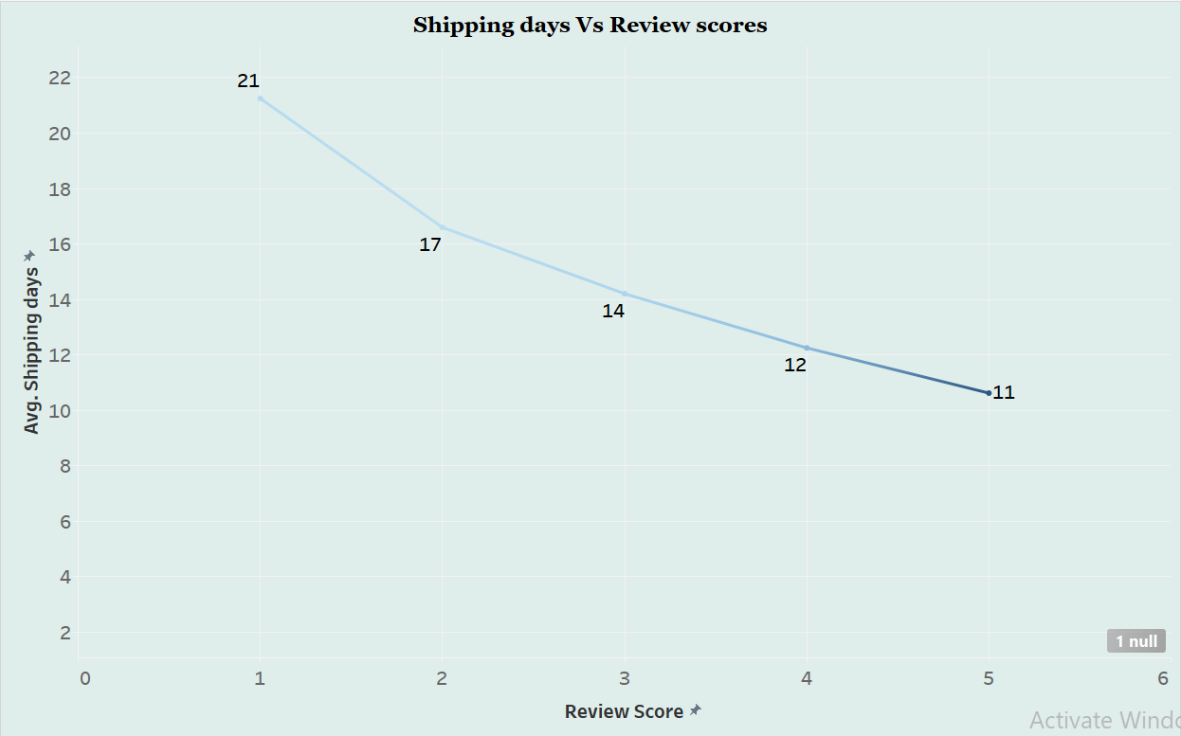
KPI – 5 Average Shipping days Vs Review score.
Insights :
The shipping days averages vary across different review scores:
Review Score 1: Average of 21.25 days (highest)
Review Score 5: Average of 10.62 days (lowest)
The considerable variation in shipping days seen between review ratings 1 and 5 suggests the possibility of differences in service quality or fulfilment effectiveness amongst various customer experiences.
Recommendations :
Enhance customer satisfaction by ensuring prompt and reliable shipping across all review scores.
Continuously evaluate and adjust pricing strategies to align with customer expectations and market trends.
Use detailed transaction data to refine operational processes, optimize pricing, and improve service delivery.

Slide 10
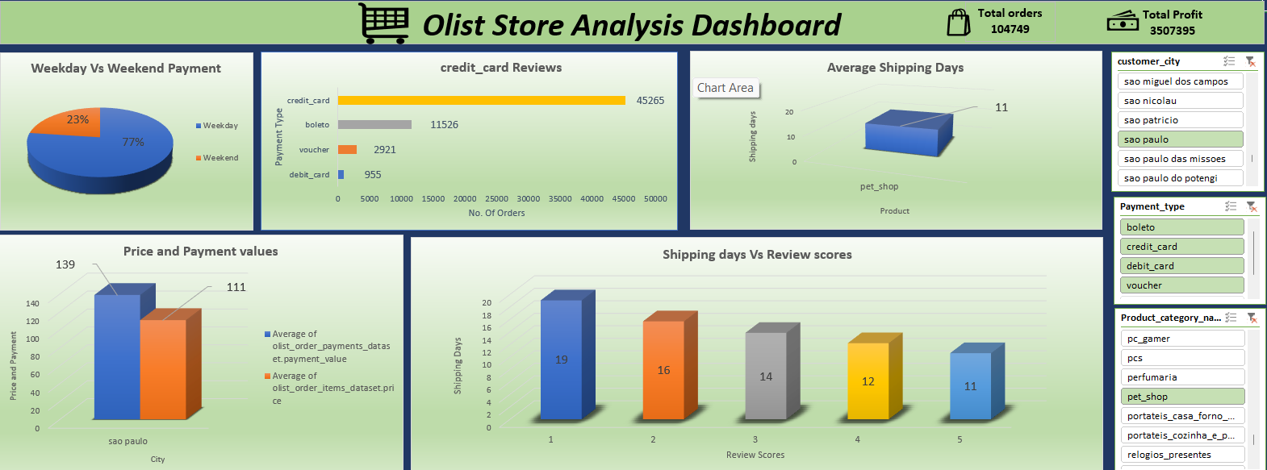
Excel Dashboard

Slide 11
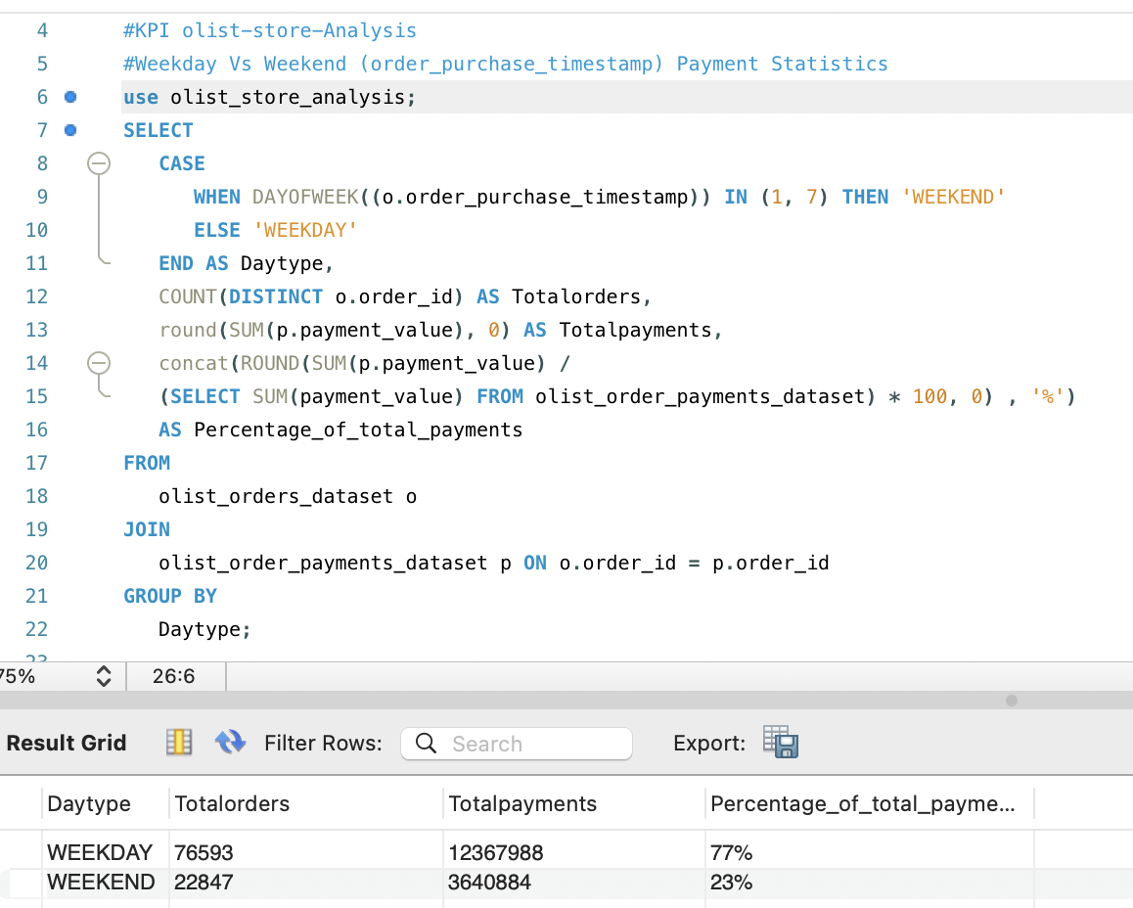
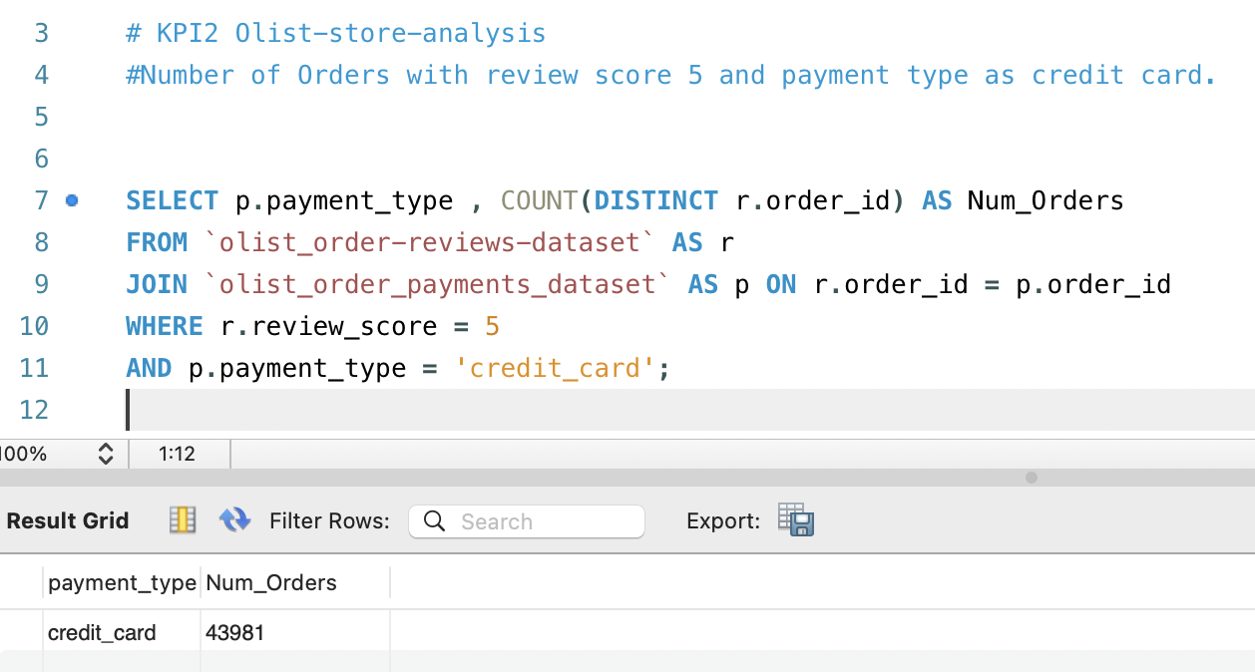
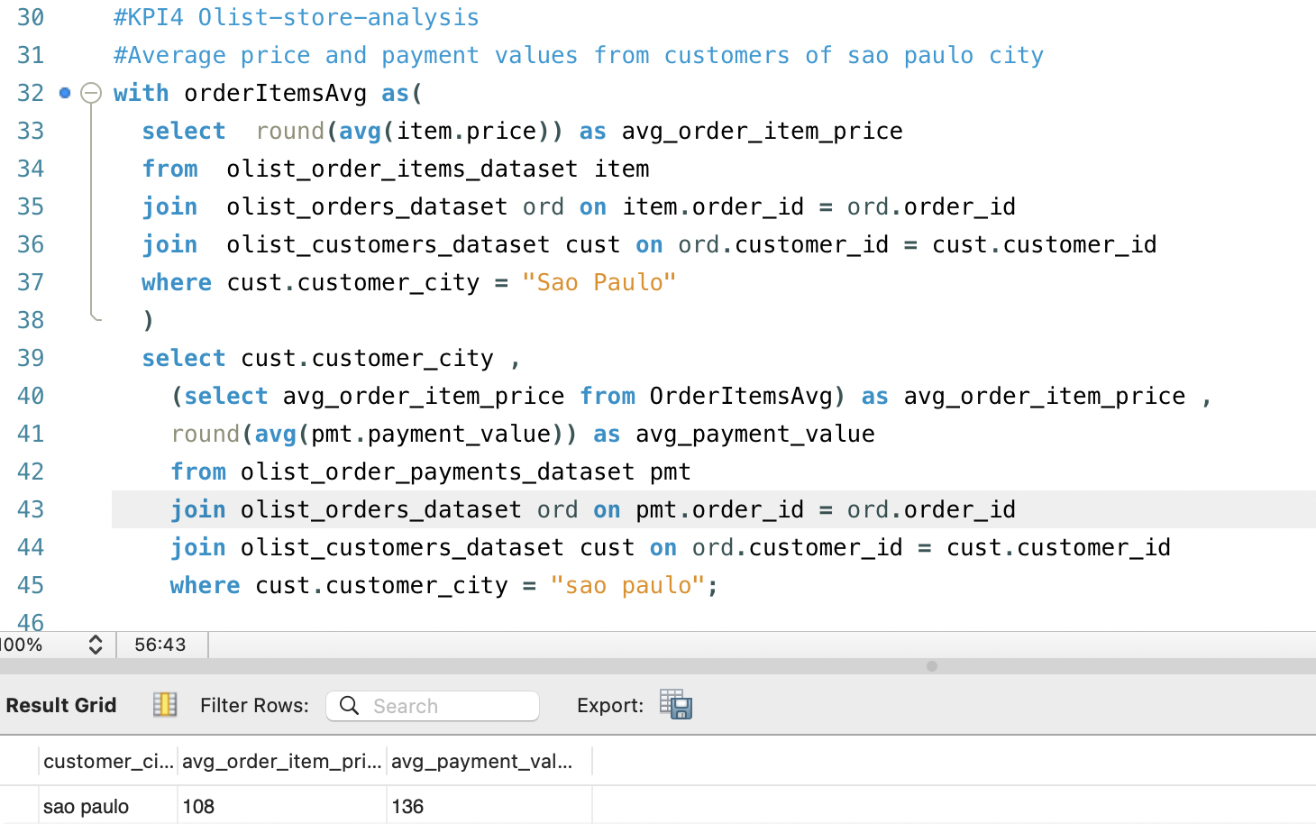
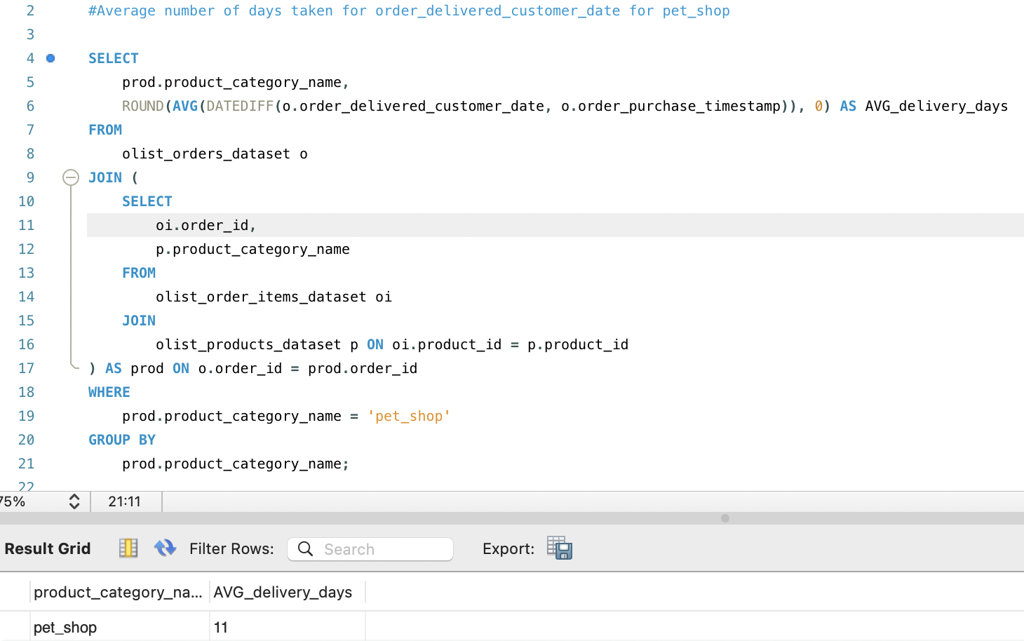
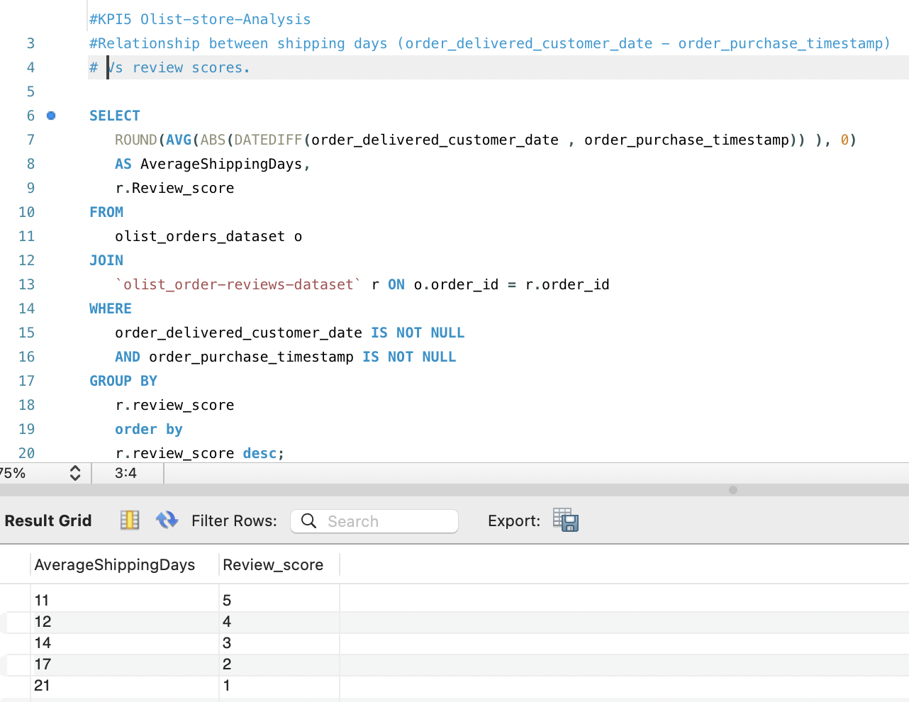
SQL Query

Slide 12
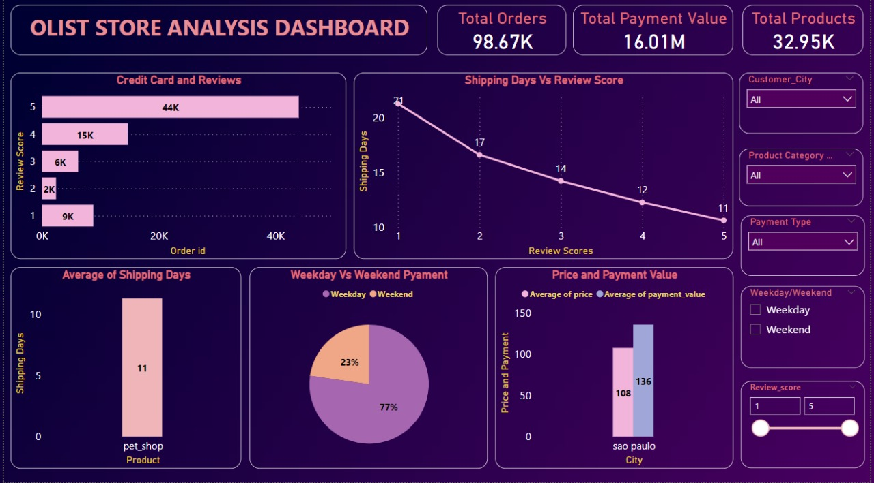
Power Bi Dashboard

Slide 13
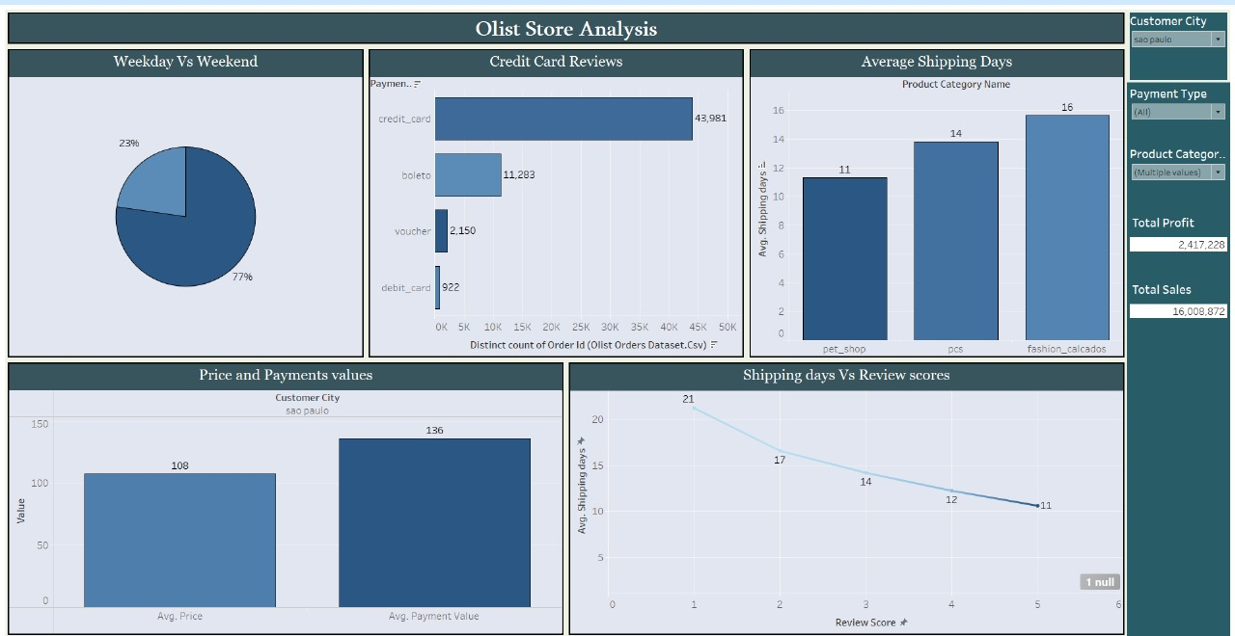
Tableau Dashboard

Slide 14
Conclusion
Weekdays are busier than weekends for payments.
Credit card payments are correlated with higher review scores.
Pet shop has an average shipping time of 11 days.
Customers in Sao Paulo have a higher average order value and payment amount than customers in other cities.
Longer shipping time can lead to lower review scores.

Slide 15
Thank You!

